Slide 1
Chapter 4
System Analysis Design
Data Flow Diagram(DFD)

Slide 2
Learning Goals
What are Data Flow Diagrams (DFDs)?
Why they are useful?
How are they developed?
How to level DFDs?
Good style conventions in developing DFDs
Difference between Logical and Physical DFDs
Tools available to draw DFDs

Slide 3
Flow-Oriented Modeling
Represents how data objects are transformed at they move through the system.
Data flow diagram (DFD) is the diagrammatic form that is used.
Considered by many to be an “old school” approach, but continues to provide a view of the system that is unique—it should be used to supplement other analysis model elements.

Slide 4
The Flow Model
Every computer-based system is an
information transform ....
computer
based
system
input
output

Slide 5
Data Flow Diagrams
WHAT ARE DATA FLOW DIAGRAMS?
DFDs models the system by depicting
External entities from which the data flows and where results terminate
Processes which transform data flows
Data stores from which the data are read or into which data are written by the processes.

Slide 6
Flow Modeling Notation
External Entity
Process
Data flow
Data store

Slide 7
External Entity
A producer or consumer of data
Examples: a person, a device, a sensor
Another example: computer-based system
Data must always originate somewhere and must always be sent to something

Slide 8
Process
A data transformer (changes input
to output)
Examples: compute taxes, determine area, format report, display graph
Data must always be processed in some
way to achieve system function

Slide 9
Data Flow
Data flows through a system, beginning
as input and transformed into output.
base
compute
triangle
area
area
height

Slide 10
Data Stores
Data is often stored for later use.
sensor #
sensor #, type,
location, age
look-up
sensor
data
report required
type,
location, age
sensor number
sensor data

Slide 11
DFD Rules and Tips
Each process should have at least one input and an output.
Each data store should have at least one data flow in and one data flow out.
Data stored in a system must go through a process.
All processes in a DFD go to another process or a data store.

Slide 12
DFD levels and layers:
From context diagrams to pseudocode
A data flow diagram can dive into progressively more detail by using levels and layers, zeroing in on a particular piece.
DFD levels are numbered 0, 1 or 2, and occasionally go to even Level 3 or beyond.

Slide 13
DFD 0
DFD Level 0 is also called a Context Diagram. It’s a basic overview of the whole system or process being analyzed or modeled.
It’s designed to be an at-a-glance view, showing the system as a single high-level process, with its relationship to external entities.
It should be easily understood by a wide audience, including stakeholders, business analysts, data analysts and developers.

Slide 14
DFD 0
DFD Level 0 is also called a Context Diagram. It’s a basic overview of the whole system or process being analyzed or modeled.
It’s designed to be an at-a-glance view, showing the system as a single high-level process, with its relationship to external entities.
It should be easily understood by a wide audience, including stakeholders, business analysts, data analysts and developers.

Slide 15
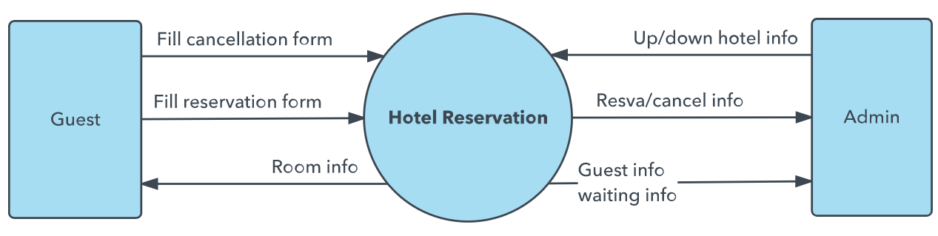
DFD 0

Slide 16
DFD-1
DFD Level 1 provides a more detailed breakout of pieces of the Context Level Diagram.
You will highlight the main functions carried out by the system, as you break down the high-level process of the Context Diagram into its sub-processes.

Slide 17
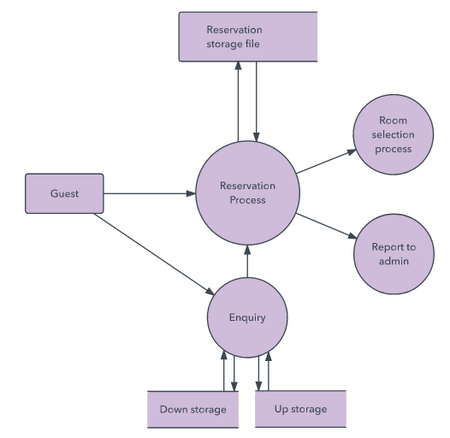
DFD-1

Slide 18
DFD-2
DFD Level 2 then goes one step deeper into parts of Level 1.
It may require more text to reach the necessary level of detail about the system’s functioning.

Slide 19
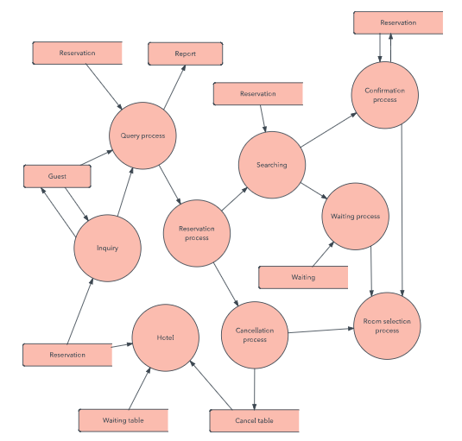
DFD-2

Slide 20
DFD 3, 4
Progression to Levels 3, 4 and beyond is possible, but going beyond Level 3 is uncommon.
Doing so can create complexity that makes it difficult to communicate, compare or model effectively.

Slide 21
Logical DFD vs. Physical DFD
A Logical DFD visualizes the data flow that is essential for a business to operate. It focuses on the business and the information needed, not on how the system works or is proposed to work.
A Physical DFD shows how the system is actually implemented now, or how it will be. For example, in a Logical DFD, the processes would be business activities, while in a Physical DFD, the processes would be programs and manual procedures.

Slide 22
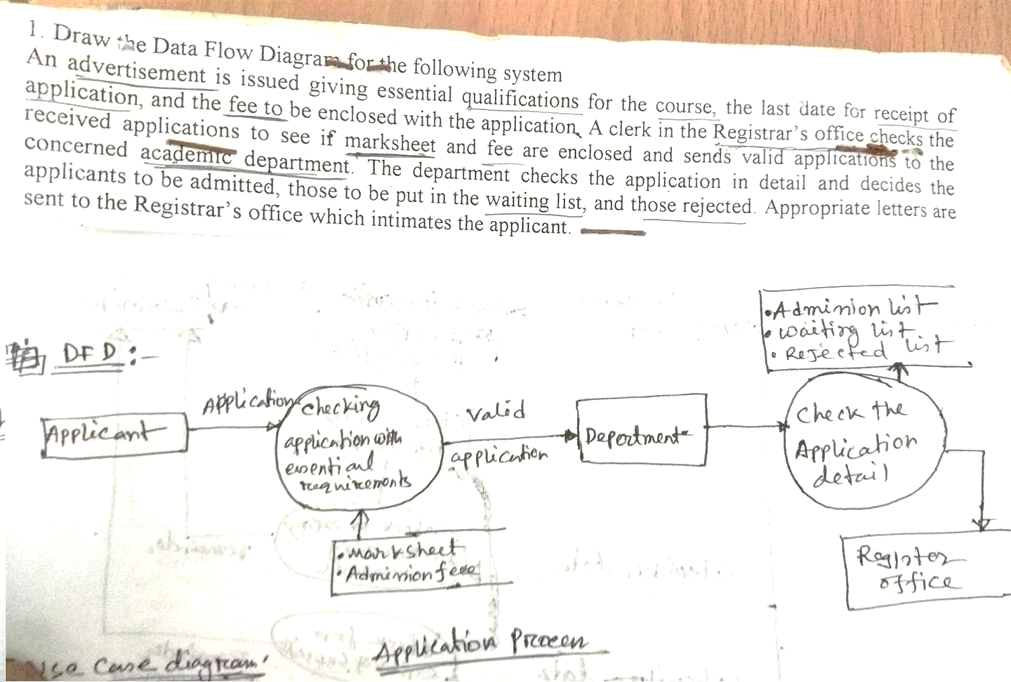
Example-1
An advertisement is issued giving essential qualifications for the course , the last date for receipt of application, and the fee to be enclosed with the application. A clerk in the Registrar’s office checks the received applications to see if marksheet and fee are enclosed and sends valid applications to the concerned academic department. The department checks the application in details and decides the applications to be admitted, those to be put in the waiting list, and those rejected. Appropriate letters are sent to the Registrar’s office which intimates the applicant.

Slide 23
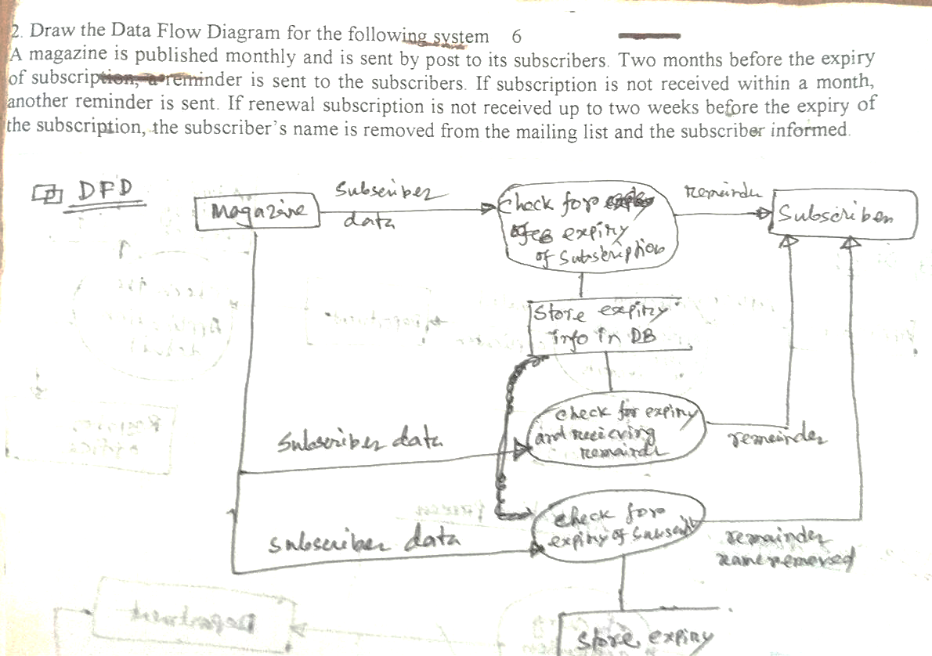
Example-2
A magazine is published monthly and is sent by post to its subscribers. Two months before the expiry of subscriptions, a reminder is sent to the subscribers. If subscription is not received within a month, another reminder is send. If renewal subscription is not received up to two weeks before the expiry of the subscriptions, the subscribers name is removed from the mailing list and the subscriber informed.

Slide 24
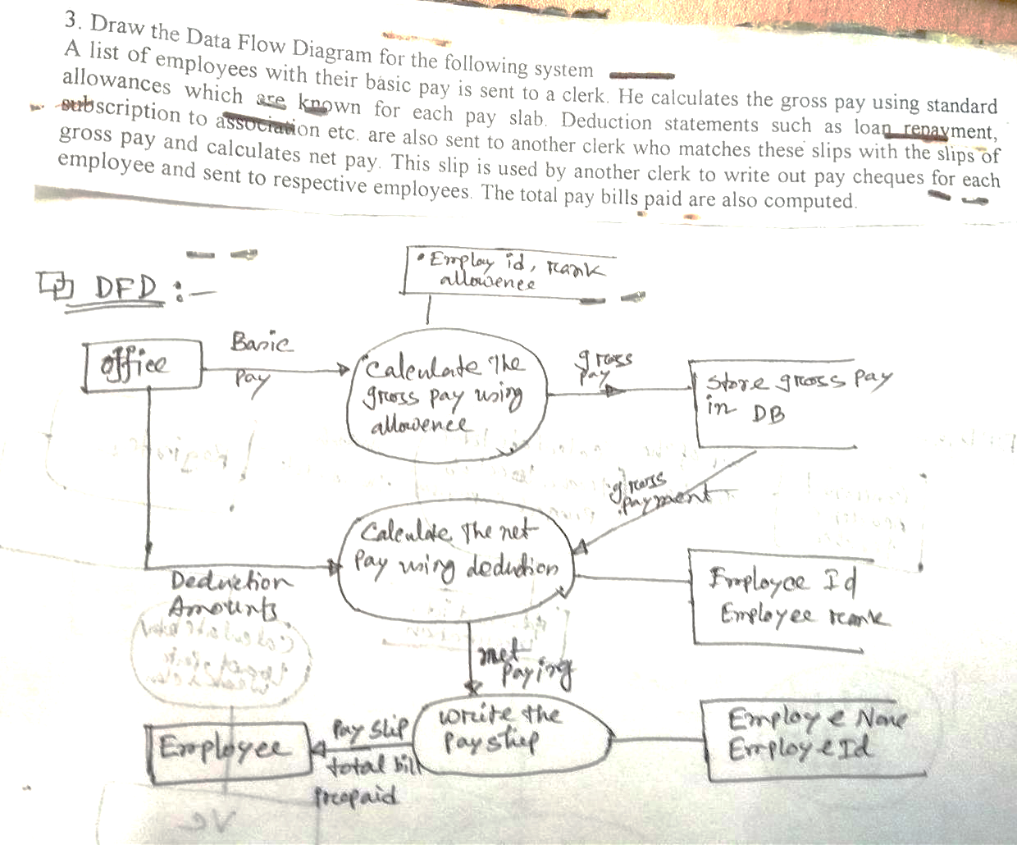
Example-3
A list of employees with their basic pay is sent to a clerk. He calculates the gross pay using standard allowances which are known for each pay slab. Deduction statements such as loan payment subscription to association etc. are also sent to another clerk who matches these slips with the slips of gross pay and calculates net pay. This slip is used by another clerk to write out pay cheques for each employee and sent to respective employees. The total pay bills paid are also computed.

Slide 25
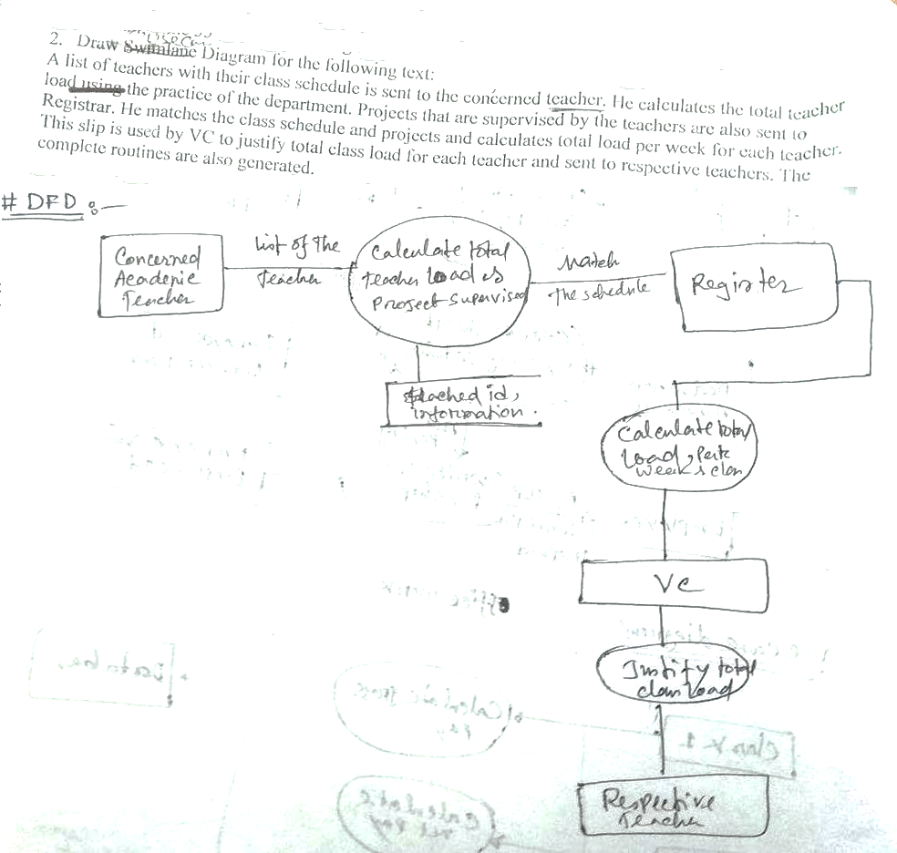
Example-4
A list of teachers with their class schedule is sent to the concerned teachers. He calculates the total teacher load using the practice of the department. Projects that are supervised by the teachers are also sent to Registrar. He matches the class schedule and projects and calculates total load per week for each teacher. This slip is used by the VC to justify total class load for each teacher and sent to the respective teachers. The complete routines are also generated.

Slide 26
Example-5
Context Diagram for Airline Reservation System

Slide 27
Level One Data Flow Diagram for Reservation Process

